Slide 1

E-Commerce Company Performance Analysis
Tools: SQL | Python | Power BI | Dataset: 25,000+ Transactions
This analysis evaluates revenue, profitability, customer behavior, and return patterns to identify strategic growth opportunities for an E-Commerce company.

Slide 2
Executive KPIs
$1.57B
$472M
30.09%
15.12%
Total Revenue
Total Profit
Profit Margin
Return Rate
Across 25,000+ transactions
Strong financial performance
Consistent profitability
Manageable customer returns
Category Performance Insights
Revenue balanced across all categories
Profit margins stable around 30%
No abnormal return behavior
Structurally stable business model

Slide 3


Time-Series Trends
Revenue Stability
Margin Consistency
Return Rate Behavior
Moderate fluctuations with consistent performance over time
Profit margin remains between 29–31% across periods
Fluctuates 12–16% without upward trend; 2026 data is YTD
Customer Behavior Insights
96%
99%
Repeat Buyers
Revenue from Repeat
Customers return for additional purchases
Almost all revenue from loyal customers
Growth driven by purchase frequency, not higher order value.

Slide 4
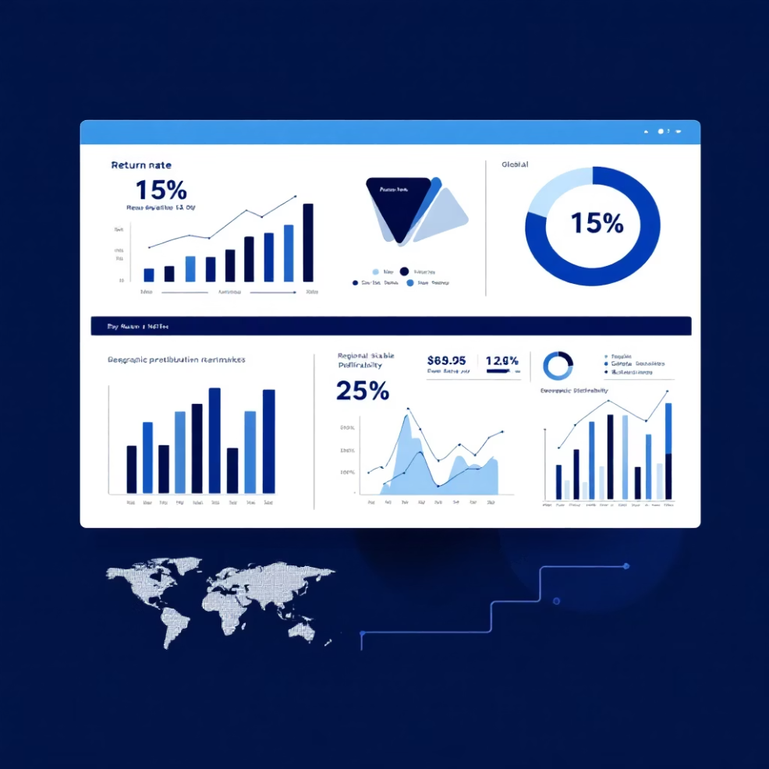

Return Rate Impact Analysis
Current State
Overall return rate: ~15%
No increasing trend over time
Structural but manageable behavior
Opportunity
Reducing return rate by 2–3% can significantly improve profitability.
Regional Performance
Even Distribution
No Underperformance
Risk Reduction
Revenue and profit balanced across all regions
No region shows major issues
Geographic diversification reduces business risk

Slide 5
Strategic Recommendations
01
02
03
Customer Loyalty Programs
Increase Purchase Frequency
Reduce Returns
Launch retention initiatives to strengthen repeat purchase behavior
Focus on repeat customers rather than higher order values
Improve product quality, descriptions, and logistics
04
05
Upselling Strategies
Accurate Trend Evaluation
Introduce targeted cross-selling to boost revenue
Monitor YTD vs full-year comparisons for reliable insights
Conclusion
The business demonstrates stable profitability, strong customer retention, and balanced category performance. Future growth should focus on customer lifetime value optimization and incremental improvements in return rate management.

Slide 6

Key Takeaways
Stable Profitability
Strong Retention
Consistent 30% profit margins across categories and time periods
96% of customers are repeat buyers, driving 99% of total revenue
Balanced Performance
Revenue and profit evenly distributed across categories and regions

Slide 7

Opportunity Areas
Return Rate Reduction
Current 15% return rate is structural but manageable. Reducing by 2–3% can significantly improve profitability.
Purchase Frequency Growth
Growth driven by frequency, not order value. Focus on increasing how often repeat customers buy.
Product Quality
Product Descriptions
Logistics
Enhance quality control to reduce returns
Improve accuracy to set proper expectations
Optimize fulfillment to reduce damage

Slide 8
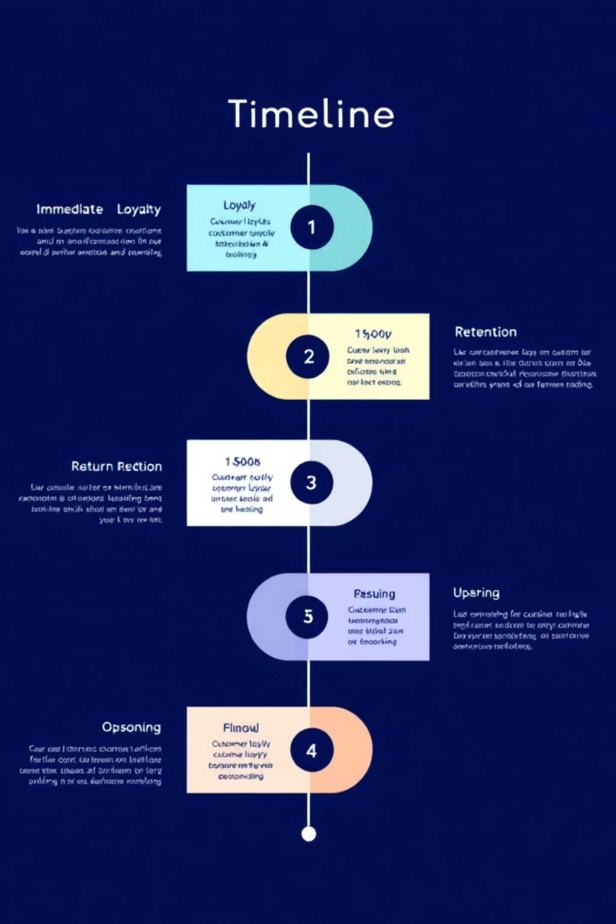
Implementation Roadmap
1
Phase 1: Immediate
Launch customer loyalty programs and retention initiatives
2
Phase 2: Short-term
Implement return reduction strategies across product categories
3
Phase 3: Medium-term
Introduce targeted upselling and cross-selling strategies
4
Phase 4: Ongoing
Monitor YTD vs full-year comparisons for accurate trend evaluation

Slide 9




Next Steps
Develop Action Plan
Set KPIs
Monitor Progress
Create detailed implementation roadmap with owners and timelines
Define measurable targets for each strategic initiative
Establish regular review cadence to track performance
Immediate Actions
Form cross-functional implementation team
Conduct customer feedback analysis
Audit current return processes
Identify quick wins for return reduction

Slide 10

Thank You
Questions & Discussion
Contact Information
Data Source
Available for follow-up discussion
25,000+ transactions analyzed
Tools Used
SQL | Python | Power BI

